Slide 1
Proximal causes of diet in the desert horned lizard Phrynosoma platyrhinos in northern desert scrub
R. Anderson, S. Wilhoit, W. Boyle
Western Washington University

Slide 2
Trophic interactions in desert systems are presumed to be strongly linked, hence:
Annual trophic patterns in desert scrub communities are expected to be strongly influenced by annual variation in temperature and precipitation.
Thus, short term effects of climate on desert scrub communities are expected as bottom-up effects in production:
  plants to herbivores (1º C)
  herbivores to predators (2º C)
  2º C to mesopredators & apex predators (3ºC).

Slide 3
The hypothesized bottom-up effects in production can be tested by correlational analyses of
  Body condition of lizards,
  Lizard abundances among years,
  Annual productivity of the lizard’s prey,
  Annual (short-term) climatic patterns in temperature and precipitation.

Slide 4
Gross Energy of Food
Apparent Digestible Energy
Fecal Losses
Urinary & Gaseous Losses
Apparent Metabolizable Energy
SDA & Fermentation Losses
Apparent Net Energy
Maintenance
Work
Production:
Growth, storage, reproduction
But, Lizard Fecal “Losses” are a Fecologist’s Gain…

Slide 5
Subject Animals
Insectivore as a 2º consumer:
  Desert Horned Lizard, Phrynosoma platyrhinos
Insects as 1º consumers:
  Harvester Ants, other ants

Slide 6
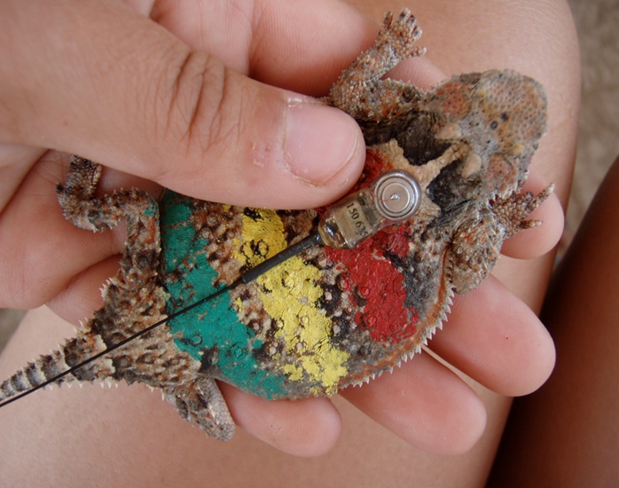
Desert horned lizard
Phrynosoma platyrhinos
Even with the transmitter, the paint helps find this cryptic & hide-prone lizard

Slide 7
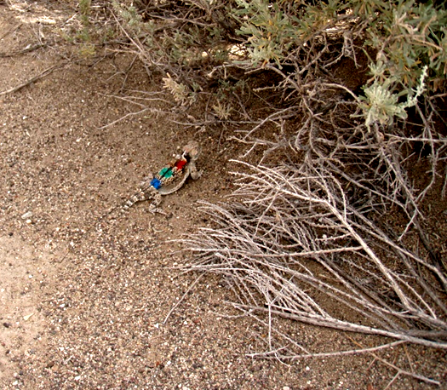

Slide 8
Research Site
  Alvord Basin, Harney Co, OR
  BLM administered public land
  Great Basin desert scrub
    20% cover by perennial vegetation
    Mix of sandy flats, dunes, and hardpan mesohabitats
  Dominant perennial shrubs:
    Basin big sage, Artemisia tridentata (ARTR)
    Greasewood, Sarcobatus vermiculatus (SAVE)

Slide 9
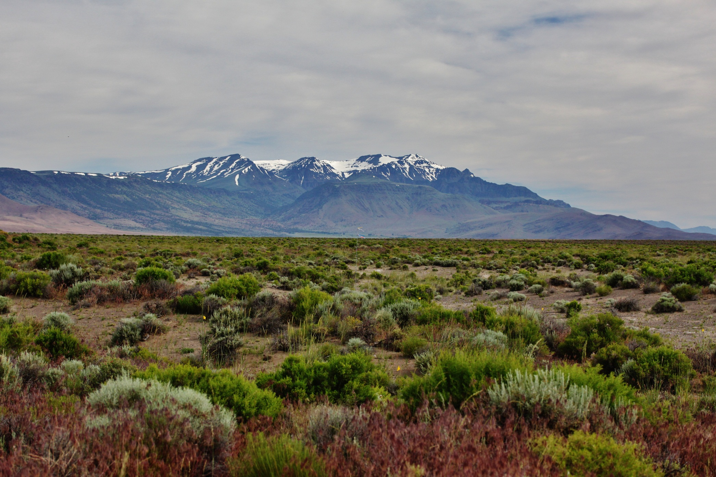
On plot, view northward of Alvord Basin, with Steens Mountain, June 2011.
(note the extensive cheatgrass in foreground)

Slide 10
Methods
Research period: late June to mid-July, 2003-2012
Standard plot surveys for ants
Standardized annual pitfall trapping
Annual census of lizards on a 4 ha core plot
Capture-mark-release lizards on 5 surrounding ha
Weather records in the field, buttressed from weather station in nearby Fields, OR, compiled by the DRI, under auspices of WRCC.

Slide 11
Monthly mean daily air temperatures near study site (Fields)
and other weather stations

Slide 12
Daily temperature patterns of
air (15-35ºC) and substratum (10-65ºC)
in the Alvord Basin during mid-summer
(presumably influence timing and location of Phryonosoma platyrhinos activity).

Slide 13
10
Month to month precipitation patterns near study site (Fields)
and at other weather stations in the region

Slide 14
Methods
Annual arthropod counts from pitfall traps
  In 2012: 168 pairs of pitfall traps caught
      28851 macroarthropods
        11642 ants
        6354 non-ant walkers & perchers
        10855 flight-prone insects
Annual grasshopper counts
  3 count episodes per plot per time of day
  3 times of day, across 9 days (~1 per day per plot),
  Eight 5m x 5m quadrats per each 10m x 40m plot,
  3 plots per mesohabitat,
  3 prevalent mesohabitats.

Slide 16
Pp 30%
At 15%
Gw 14%

Slide 17
Methods
Annual arthropod counts from pitfall traps
  In 2012: 168 pairs of pitfall traps caught
      28851 macroarthropods
        11642 ants
        6354 non-ant walkers & perchers
        10855 flight-prone insects
Annual Ant counts
  3 count episodes per plot per time of day
  3 times of day, across 9 days (~1 per day per plot),
  Eight 5m x 5m quadrats per each 10m x 40m plot,
  3 plots per mesohabitat,
  3 prevalent mesohabitats.

Slide 18
Patterns of Arthropod Abundance in Pitfall Traps 2004-2011
Analysis of Variance*
Source Type III SS df Mean Squares F-ratio p-value
Year 357,964.706 7 51,137.815 75.328 0.0001
Mesohabitat 31,120.345 2 15,560.172 22.921 0.0001
Plant Species 10,577.248 1 10,577.248 15.581 0.0001
Plant Size 2,503.398 2 1,251.699 1.844 0.159
Error 494,893.417 729 678.866
*Post hoc tests revealed these significant differences in annual abundances:
Higher in 2005, 10, and 11 relative to 2004, 06-09
Rainfall total in both May 2010 & 2011 were about 3.75 cm

Slide 19
Ants caught in pitfall traps reveal
3 of the larger ant species as more available in sandy flat microhabitats
 | POCA | MYKE | CRMO | DOIN | APME | CAHY | MELA | TENA | TECH | FOPR | FOMC
SAVE | 10.2 | 7.2 | 45.5* | 6.7 | 3.6 | 0.8 | 1.00 | 1.3 | 0.9 | 0.1 | 2.6
ARTR | 12.3 | 4.9 | 79.0* | 5.2 | 1.8 | 1.5 | 0.6 | 2.0 | 0.3 | 0.7 | 3.3
OPEN | 8.6 | 10.0 | 4.8 | 3.3 | 1.0 | 1.3 | 0.9 | 0.4 | 1.1 | 2.0 | 0.3
* Includes data from inadvertent placements of pitfall traps near colony entrances
N = 350 pitfall traps for 7 trap days in summer 2012
Rarer 7-8 species of ants are not reported here

Slide 20

Measures of abundance of ant colonies
(Most were seen in open areas on the 10 x 40 m plots in two mesohabitats)
Ants | Dune | Sandy Flat
Pogonomyrmex (Poca) | 31.8 | 9.0
Temnothorax (Tene) | 6.0 | 7.8
Myrmecocystus (Myke) | 6.0 | 4.2
Crematogaster (Crmo) | 1.2 | 0?
Unknown | 10.8 | 4.2
Total | 55.8 | 25.2
Note: given the average P. platyrhinos home range of 1.66 + 0.8 ha, then there are approximately 1000 ant colonies per horned lizard home range.
Crmo are under-represented because they are hidden under plants

Slide 21
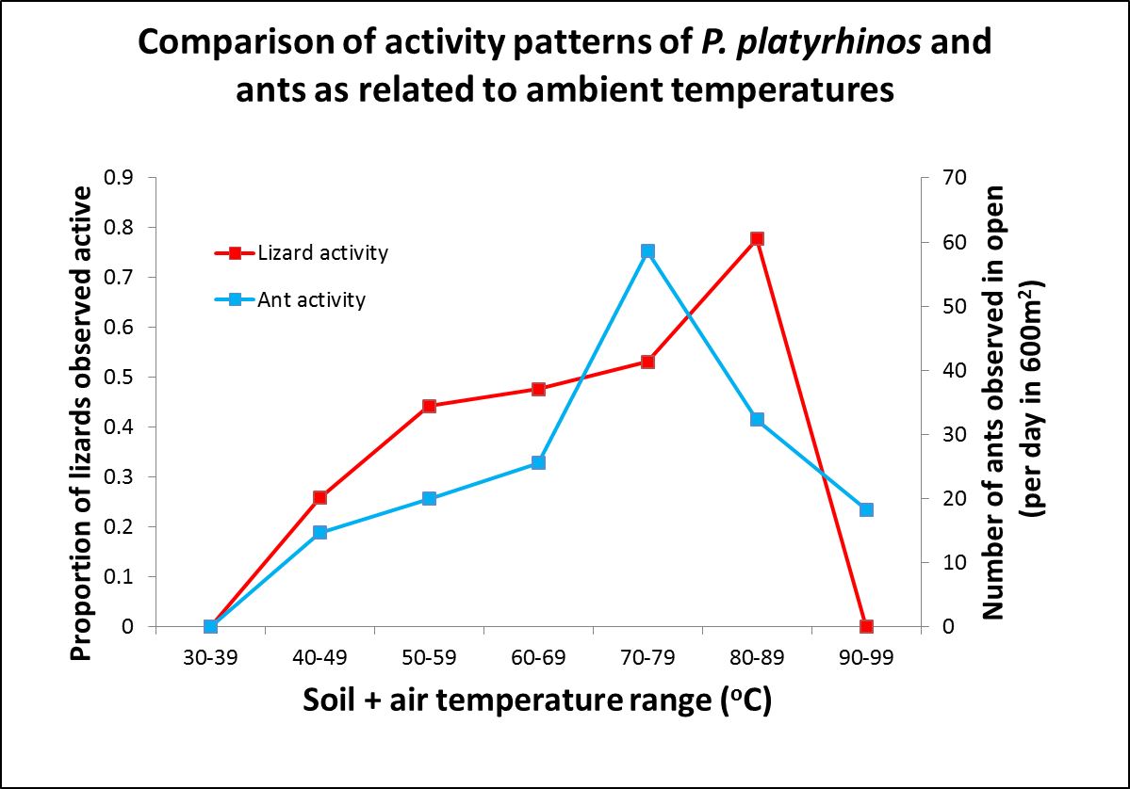

Slide 22
Preliminary video records in 2012 corroborate prior direct observation studies: more Pogonomyrmex californicus to eat
Species | # colonies & time observed per colony (min) | # Ants incoming or outgoing per min | # activity peaks per hour | # Ants per peak | # Ants per min in peak | Duration of peak (min) | # min/hr in peaks | % of available ants in peaks
POCA | 6, 84 | 9.12 | 7.168 | 52.69 | 13.78 | 3.51 | 25.160 | 59.87
MYKE | 2, 68 | 5.25 | 2.647 | 77.88 | 23.59 | 2.75 | 7.300 | 66.55
Thus, considering the two species that are most active in open areas, POCA is more available as prey

Slide 23
Thirteen of the 18 ant species on site were prey of P. platyrhinos in 2012
 | POCA | MYKE | CRMO | TENA | CAHY | MAUT
Total | 10498 | 1000 | 1221 | 433 | 349 | 207
Mean | 262.45 | 25.00 | 30.53 | 10.83 | 8.73 | 5.18
% | 71.12 | 6.77 | 8.27 | 2.93 | 2.36 | 1.40
MELA | APME | FODE | DOBI | FOPR | TECH | POSA
136 | 85 | 84 | 72 | 15 | 6 | 1
3.40 | 2.13 | 2.10 | 1.80 | 0.38 | 0.15 | 0.03
0.92 | 0.58 | 0.57 | 0.49 | 0.10 | 0.04 | 0.01
40 lizards, 178 fecal pellets,
4.5 fecal pellets per lizard (4.5 days of feeding),
totaling about 369 ants per lizard,
14,762 ant prey among the 40 lizards in 2012

Slide 24
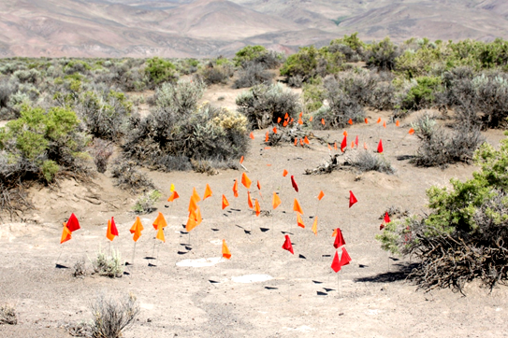
Powder-tracked trail of Desert Horned Lizard

Slide 25
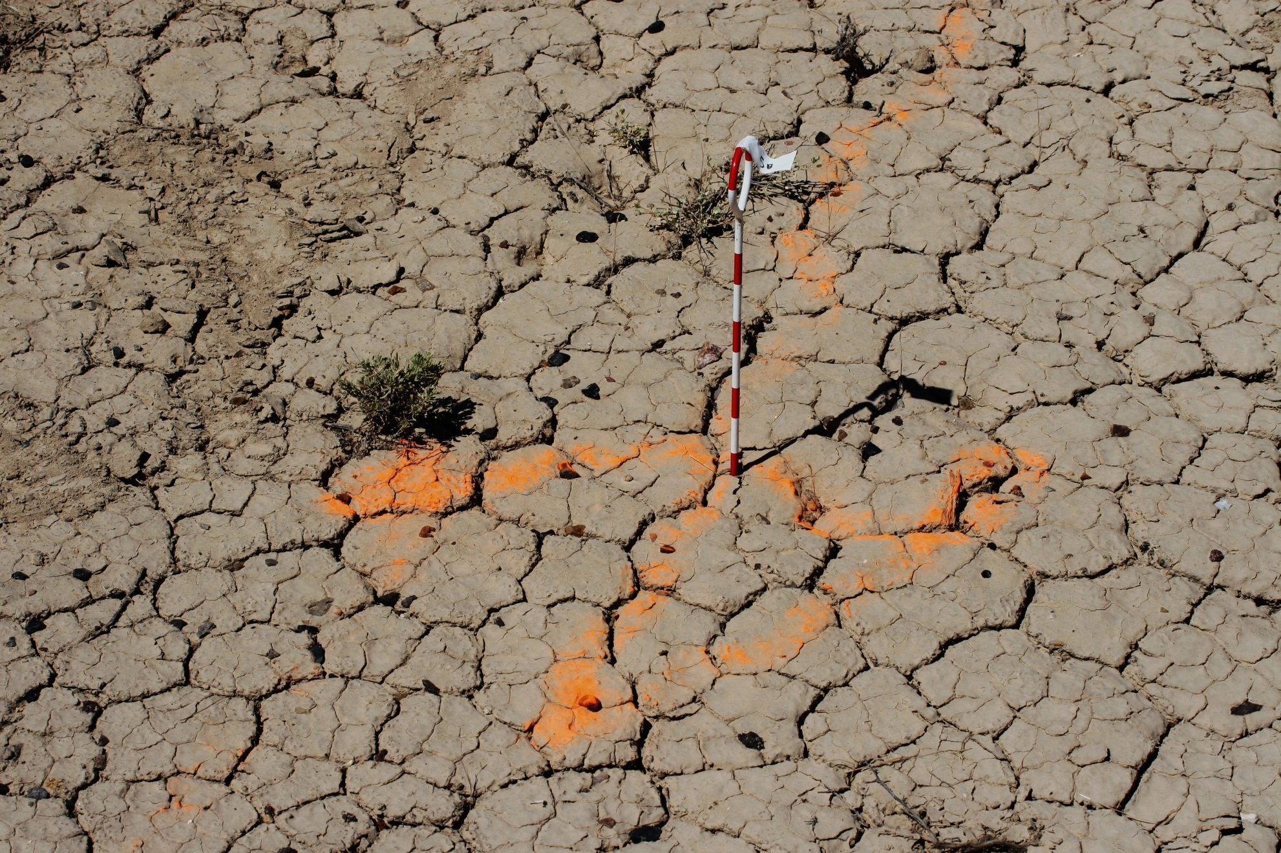
The first few meters are visible by powder tracking even during the day

Slide 26
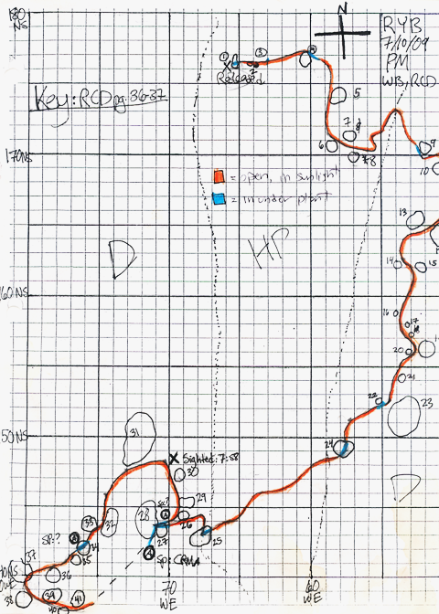
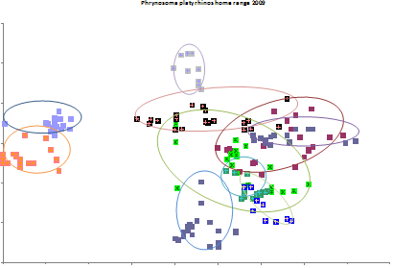
Powder track map
Approximate home ranges of
radio tracked P. platyrhinos in 2009
100 m

Slide 27
Spatial pattern of P. platyrhinos movement relative to shrub locations
 | Dune | Sand flat
Shrubs per Ha | 4720 | 4140
Average # of shrubs near powder track | 31.9 | 24.7
Average # of shrubs used for cover | 6.6 | 3.5
Average distance travelled in foraging period | 47.7m | 33.6m
Distance travelled in the open | 41.1m | 30.1m
Distance travelled under cover of shrub | 6.6m | 3.5m

Slide 28
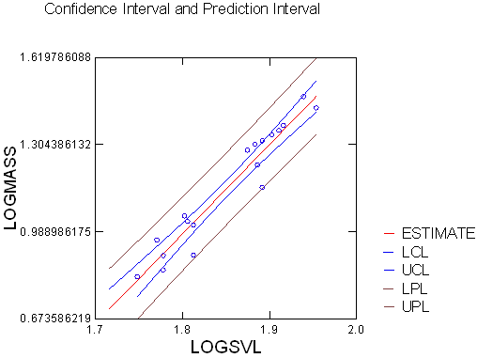
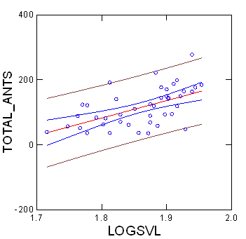
Strong correlates with lizard SVL: gut-empty lizard mass & # ants in largest fecal pellet
1.62
N= 18 P. platyrhinos
N= 43 P. platyrhinos
1.30
Log Mass (g)
0.99
2012
2012
0.67

Slide 29
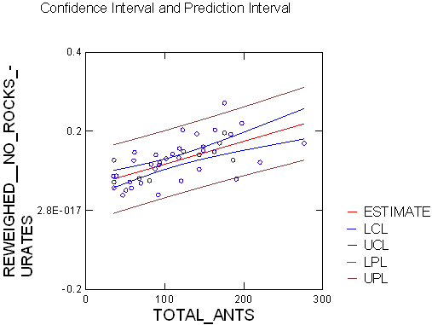
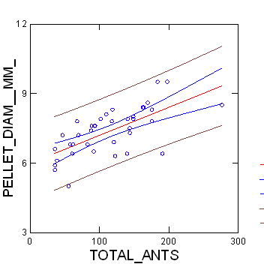
Fecal pellet mass & size correlate with # of ants in the pellet
Log Mass of Pure Pellet
N= 38 pellets, one per PHPL in 2012
(Similar pattern with only Harvester Ants, Pogonomyrmex californicus)

Slide 30
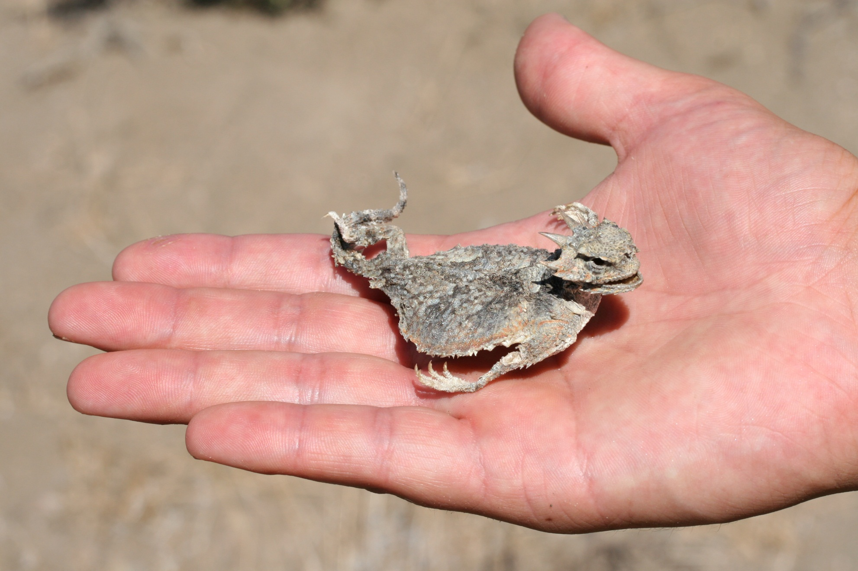
Some females are thin & have stomachs laden with nematodes, then die shortly after egg-laying…

Slide 31
Considerations
Weighing gut-empty lizards is an estimate of “condition index”
Other ways to compare among individuals for production-related outcomes:
Fecal pellet size (& mass, if one is careful careful)
Counting & identifying size of prey in fecal pellet mass
Documenting spatiotemporal patterns of prey availability
Individual activity time and activity intensity
(focal observations aided by tracking methods)

Slide 32
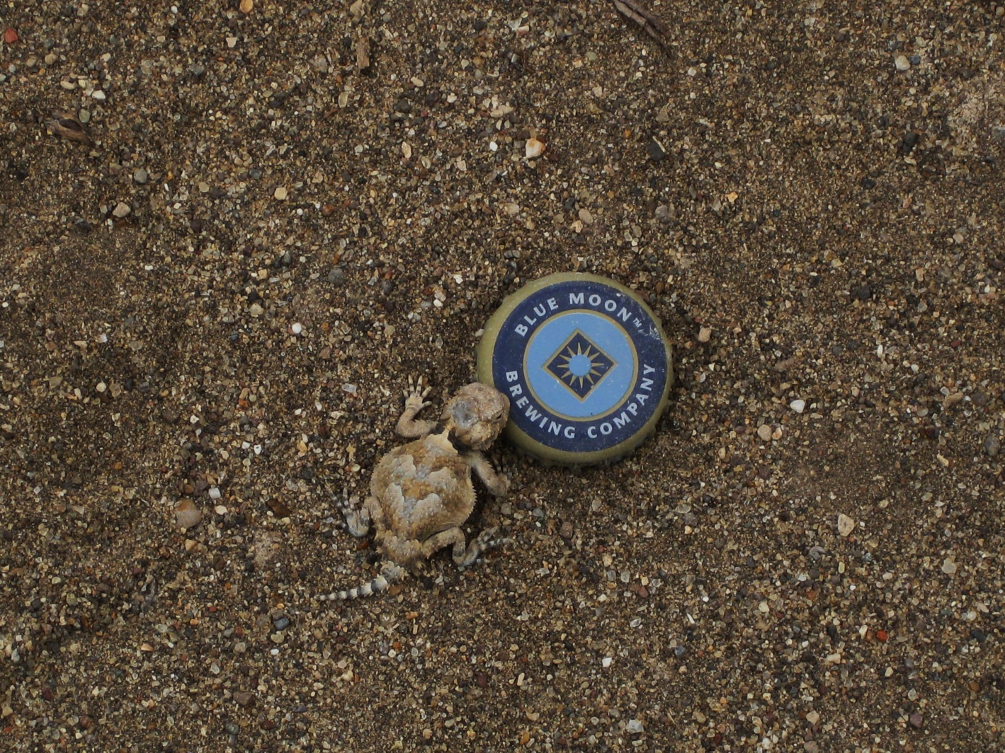
Mechanistic studies of population changes are needed.
This parasite-host relationship is an opportunity.
We are ready to embark on DLW studies across seasonal & annual extremes in this far-northern desert.

